Slide 1

CISC VS RISC ARCHITECTURE
Computer Organisation & Architecture

Slide 2
CISC VS RISC ARCHITECTURE
CISC is a computer architecture in which the processor supports a large number of complex instructions.
Each instruction can perform multiple low-level operations, such as loading data from memory, performing an arithmetic operation, and storing the result back to memory — all in a single instruction.
CISC instruction
ADD A, B
This might read A and B directly from memory, add them, and store the result back — all in one instruction

Slide 3
Objectives of CISC:
Reduce the number of instructions in a program
Make programming easier (especially in assembly)
Reduce memory usage by writing fewer lines of code.
Instead of LOAD A, B; ADD A, C; STORE A, D , a CISC might have a single instruction like ADD [B], [C], [D] (hypothetical, but illustrates the point) that adds values at memory locations B and C and puts the result in D.

Slide 4
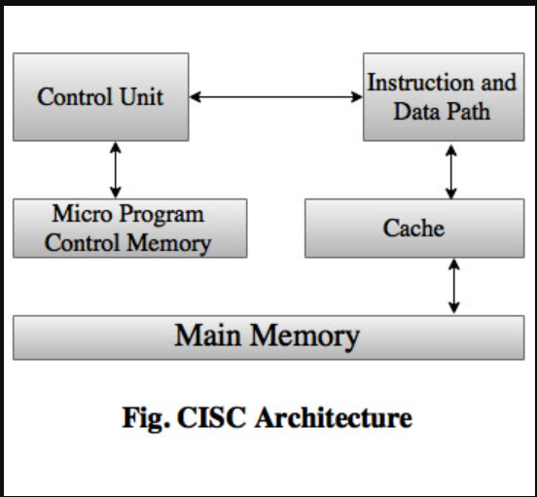
ARCHITECTURE

Slide 5
Fetch: The CPU fetches a complex instruction (e.g., ADD M1, M2) from memory.
Decode (Microprogram Control Unit): The instruction goes to the Microprogram Control Unit. This unit looks up its control memory and generates a sequence of micro-instructions.
Execute (Data Path): These micro-instructions control the processor's hardware (ALU, registers, memory access) to perform the steps:
Load data from memory address M1 to a register.
Load data from memory address M2 to another register.
Add the values in the registers.
Store the result back to a specified memory location

Slide 6
Characteristics of CISC
1. Large Instruction Set
CISC processors may have hundreds of instructions
Some instructions are very complex and take many steps to execute
2. Variable-Length Instructions
Instructions can be 1 byte, 2 bytes, or more
This makes instruction decoding slow and complex
3. Memory-to-Memory Operations
Many CISC instructions can access memory directly
4. Multiple Clock Cycles
A single instruction may take multiple clock cycles to complete
A clock cycle is the time taken by the processor clock to go from one state to the next.
The speed of the processor depends on how many clock cycles occur per second.

Slide 7
5. Microprogrammed Control Unit
CISC processors usually use a microprogrammed control unit
This increases hardware complexity but supports complex instructions
6. Many Addressing Modes
Supports many ways to access memory (direct, indirect, indexed, etc.)
7. Difficult to Pipeline
Because instructions vary in length and execution time, pipelining is inefficient
Pipelining means dividing the execution of an instruction into multiple stages and overlapping these stages for different instructions to improve overall CPU performance and throughput.
Examples of CISC:
•Intel x86 family (8086, 80286, Pentium, etc.) •VAX •Motorola 68000

Slide 8
RISC- REDUCED INSTRUCTION SET COMPUTERS
RISC simplifies processor design by using a small, uniform set of instructions.
Each instruction performs a basic operation (e.g., load, compute, store) and
is designed to execute in a single clock cycle, enabling efficient pipelining and simpler hardware.
One machine instruction per machine cycle:- A machine cycle is defined to be the time it takes to fetch two operands from registers, perform an ALU operation, and store the result in a register.
Example: ARM(Advanced RISC Machine), MIPS, SPARC, RISC-V

Slide 9
Characteristics of RISC
Simpler instruction, hence simple instruction decoding.
Instruction comes in the form of one word.
An instruction takes a single clock cycle to get executed.
More general-purpose registers for register-to-register operations.
Simple Addressing Modes.
Optimized for pipelining due to uniform instruction size and simplicity.

Slide 10
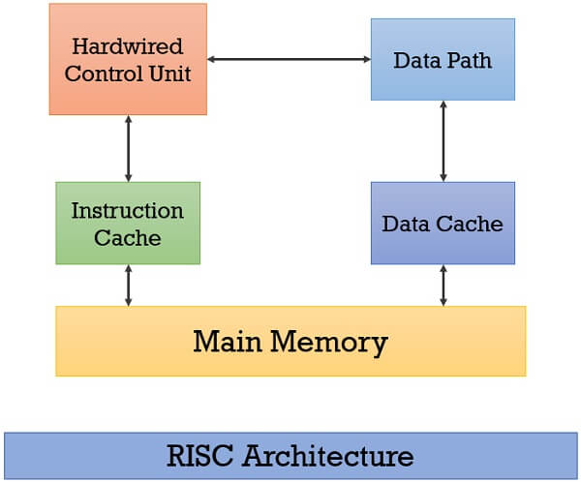
architecture

Slide 11
Basic Principles of RISC
1. Load/Store Architecture
Only two types of instructions can access memory:
LOAD–Transfers data from memory to register
STORE–Transfers data from register to memory
All other operations are done between registers
LOAD R1, A
LOAD R2, B
ADD R3, R1, R2
STORE R3, C

Slide 12
2. Fixed-Length Instructions
All instructions are same length (usually 32 bits)
This allows: • Faster fetching • Easier decoding • Efficient pipelining
3. Large Number of Registers
RISC processors have more general-purpose registers
This: • Reduces memory access • Increases speed.
4. Simple Addressing Modes
Very few addressing modes (usually 3–5)
Makes circuit design simple

Slide 13
5. Hardwired Control Unit
Uses a hardwired control unit instead of microprogramming
This is faster and more efficient
6. Easy Pipelining
boosts performance by breaking instruction execution into stages (like Fetch, Decode, Execute, Memory, Writeback) and overlapping them)

Slide 14
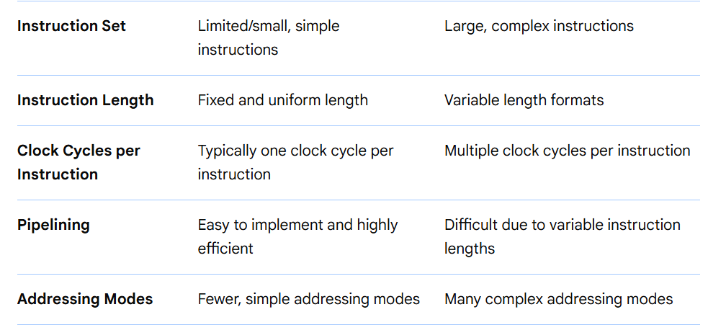
RISC VS CISC

Slide 15
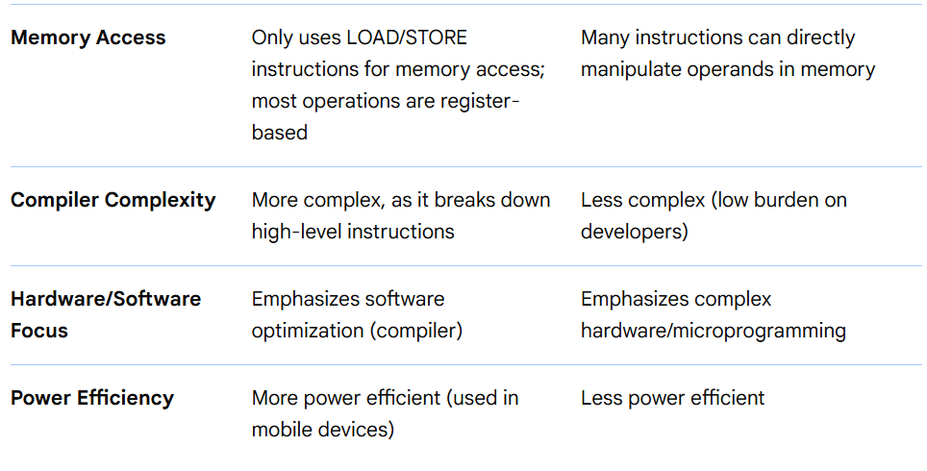

Slide 16
Risc assembly language
What is Assembly Language?
Assembly language is a low-level programming language that uses mnemonics to represent machine instructions.
ADD R1, R2, R3
R1 ← R2 + R3
General format : OPCODE DEST, SOURCE1, SOURCE2
START: ADD R1, R2, R3 ; R1 = R2 + R3
SUB R4, R1, #5 ; R4 = R1 - 5

Slide 17
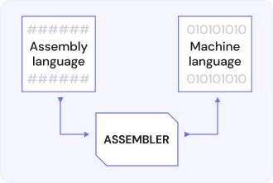
BASIC ASSEMBLER FEATURES
Translates mnemonic operation codes to their machine language equivalents and assigning machine addresses to symbolic labels used by the programmer.
ie, Program for converting instructions within low-level assembly code into relocatable machine code. It generates instructions by evaluating the mnemonics in the operation field and find the value of symbols and literals to produce

Slide 18
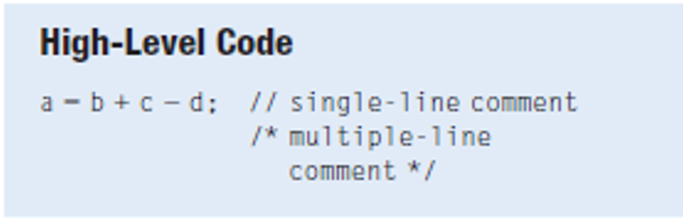
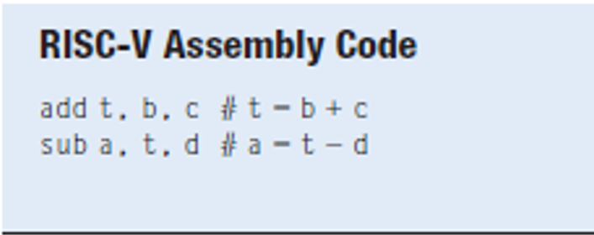
Design Principle : RISC V: Simplicity favors regularity
Consistent instruction format
Same number of operands (two sources and one destination)
Easier to encode and handle in hardware

Slide 19
RISC-V includes only simple, commonly used instructions
Hardware to decode and execute instructions can be simple, small, and fast.
More complex instructions (that are less common) performed using multiple simple instructions .
RISC-V is a reduced instruction set computer (RISC), with a small number of simple instructions.
Other architectures, such as Intel's x86, are complex instruction set computers(CISC)

Slide 20
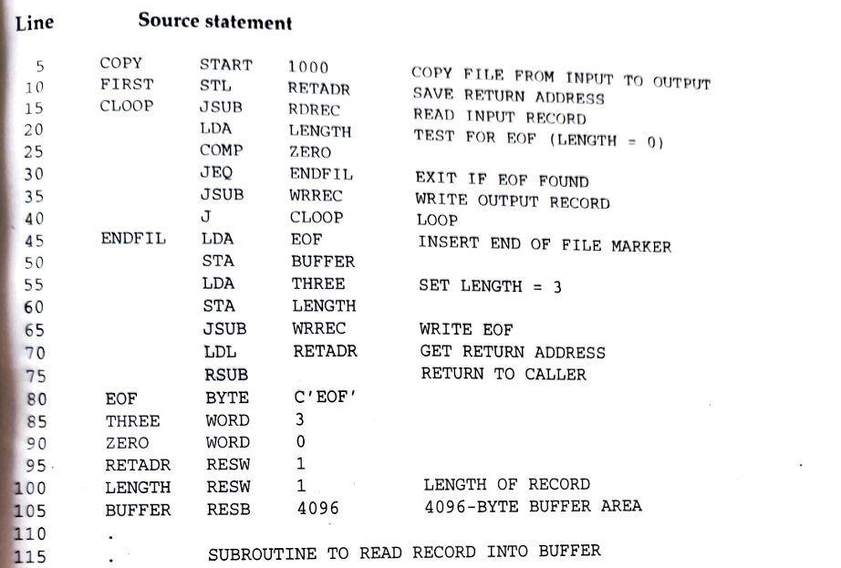
ASSEMBLER LANGUAGE PROGRAM
Mnemonic opcode of Instructions
Line nos
Address Labels
Operands
Comments

Slide 21
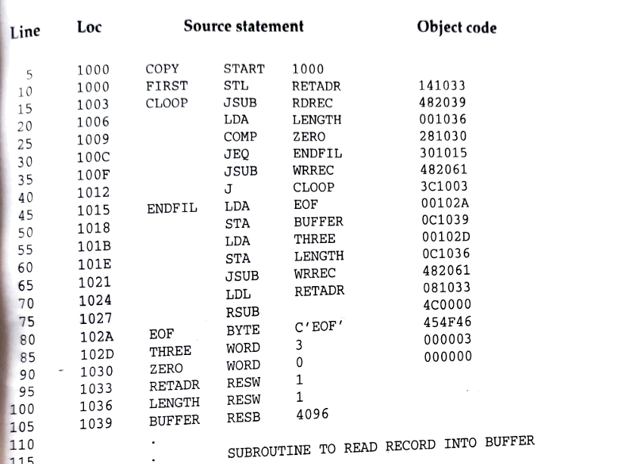
Program with the object code
Machine Address
Binary Object Code in Hexa decimal

Slide 22
Assembler directives
Assembler Directives must be processed along with the translating instructions.
They are not translated into the machine instructions,
But provide instructions to the assembler itself
START, END – Specifies the starting memory address and End of program respectively
BYTE , WORD – Direct the assembler to generate constants as part of object program,
RESW, RESB – Instruct the assembler to reserve memory locations without generating data values.
Finally Assembler must write the generated object code onto some output device. This is later loaded into memory for execution.

Slide 23
What are Assembler Directives?
Assembler directives (pseudo-ops) do not generate machine code. They instruct the assembler how to:
Allocate memory
Define constants
Control program structure
Directive | Purpose
.data | Start data section
.text | Start code section
.word | Define integer data
.byte | Define byte data
.space | Reserve memory
.global | Declare global label
.end | End of program

Slide 24
Assembling
Object File Generation: The output of the assembler is an object file, which contains machine code and information about symbols and data locations.
Linking: A linker combines multiple object files and necessary software libraries into a single, final executable program.
Execution: The executable file is loaded into memory and run by the processor.

Slide 25
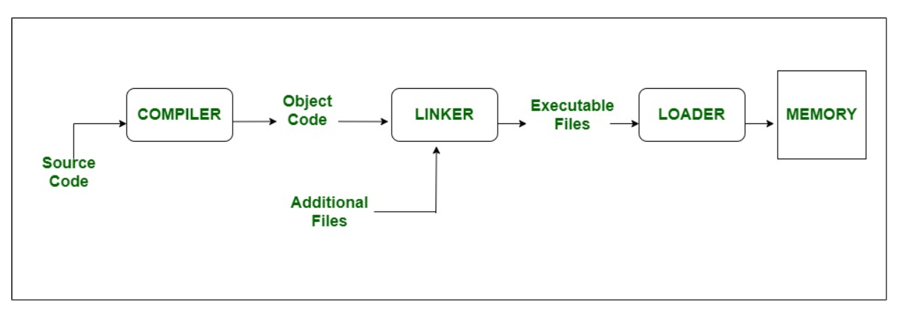
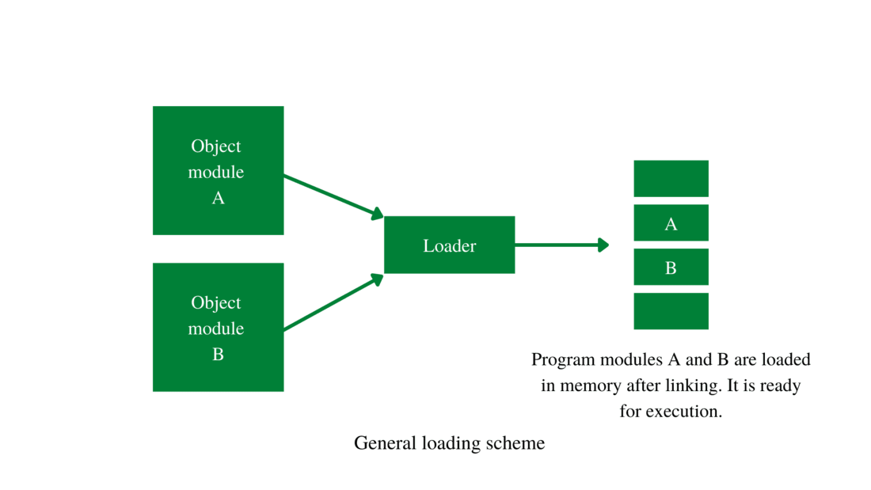

Slide 26
PASS 1 : DEFINE SYMBOLS
Assign addresses to all statements in the program
Save the addresses assigned to all labels for use in Pass 2
Perform some processing of assembler directives (that affects address assignment)
PASS 2 : ASSEMBLE INSTRUCTIONS AND GENERATE OBJECT PROGRAM
Assemble Instructions (translating operation codes and looking up addresses)
Generate data values defined by BYTE , WORD etc
Perform processing of assembler directives not done during pass 1
Write the object program and assembly listing.

Slide 27
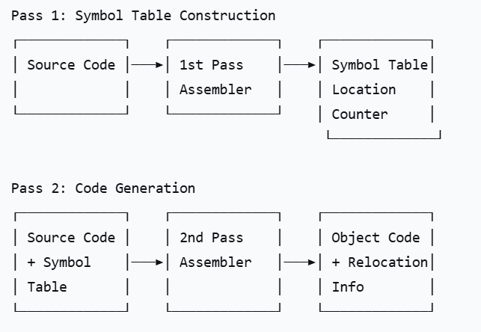

Slide 28
Thankyou

